Slide 1
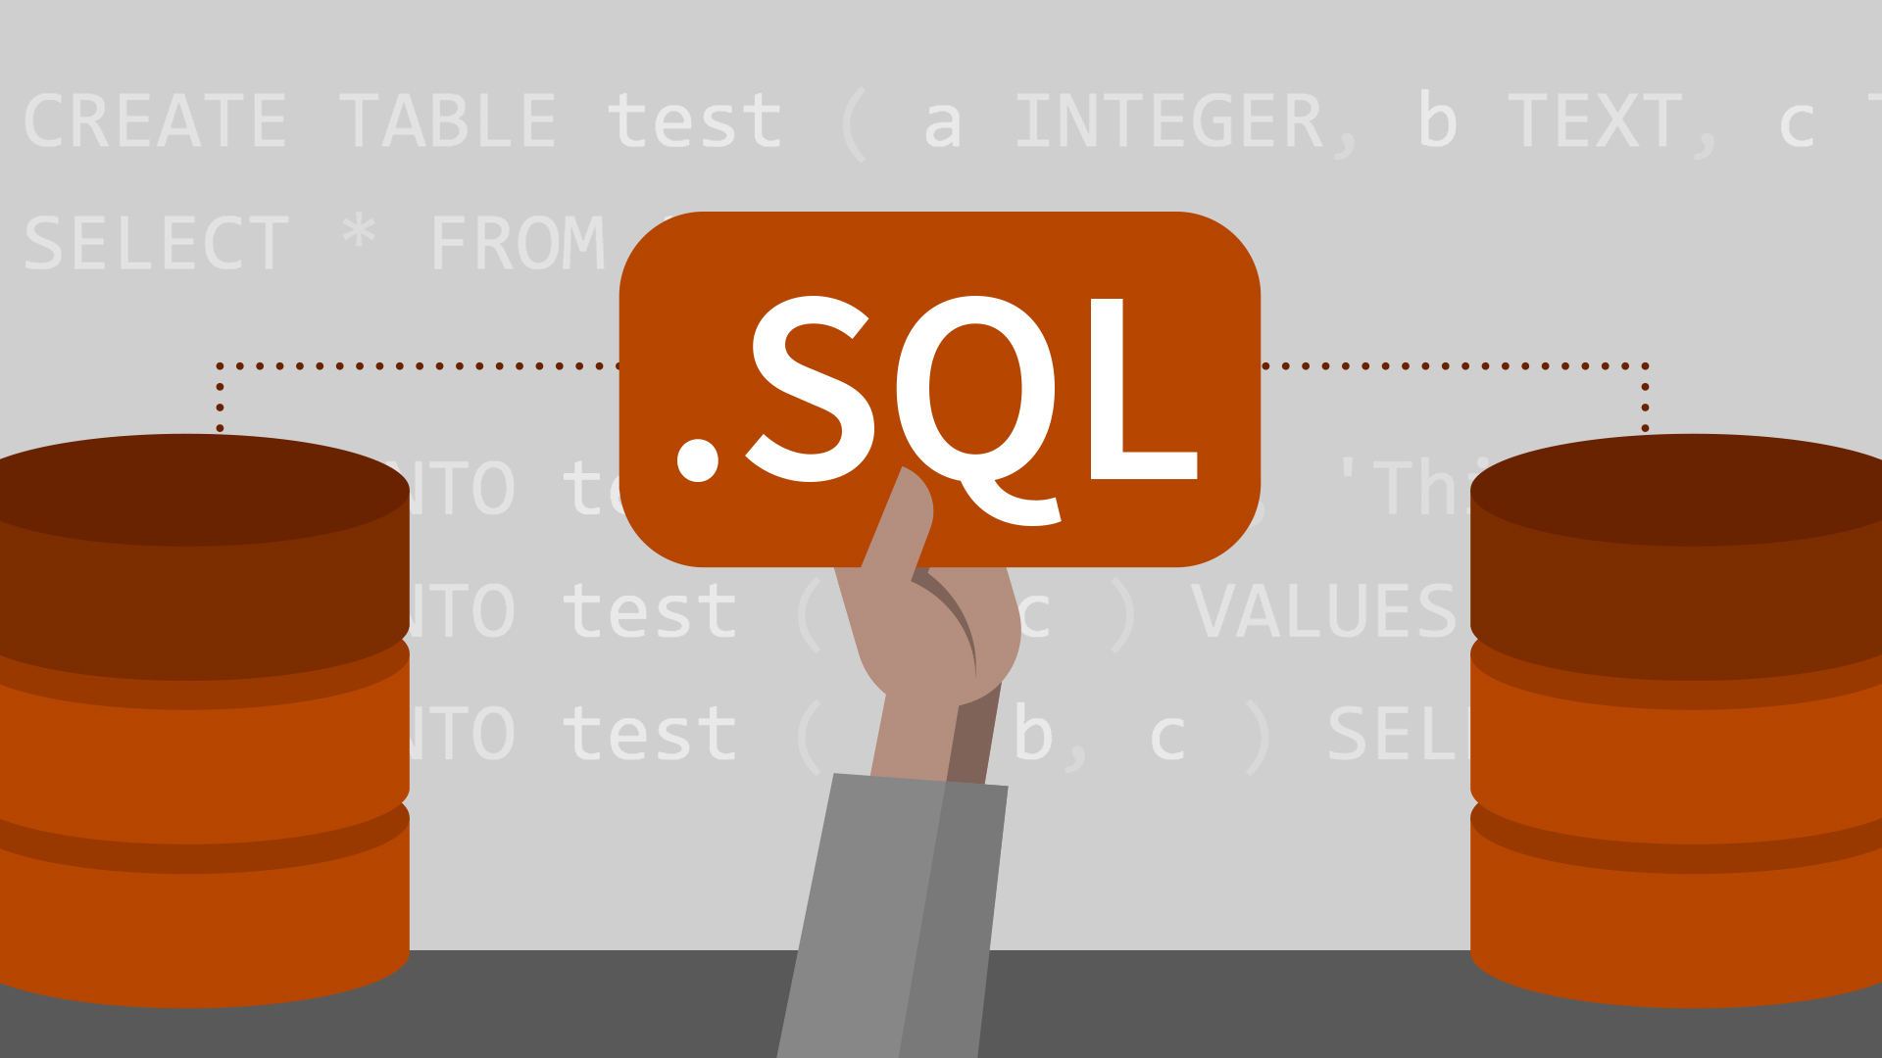

Slide 2


Introduction to SQL
What is Oracle Database?

Slide 3
What is SQL?
SQL is Structured Query Language, which is a computer language for storing, manipulating and retrieving data stored in relational database.
SQL is the standard language for Relation Database System. All relational database management systems like MySQL, MS Access, Oracle, Sybase, Informix, postgres and SQL Server use SQL as standard database language.

Slide 4

Why SQL?
Allows users to access data in relational database management systems.
Allows users to describe the data.
Allows users to define the data in database and manipulate that data.
Allows to embed within other languages using SQL modules, libraries & pre-compilers.
Allows users to create and drop databases and tables.

Slide 5
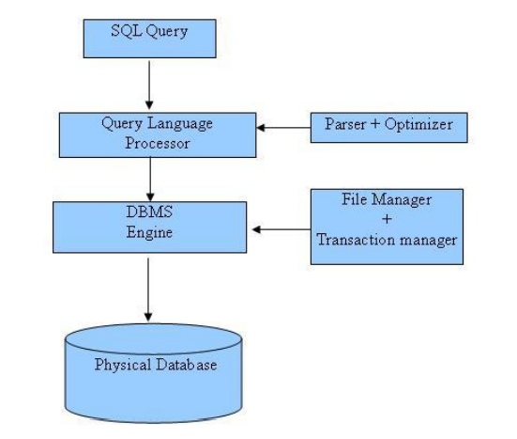
SQL Architecture?

Slide 6
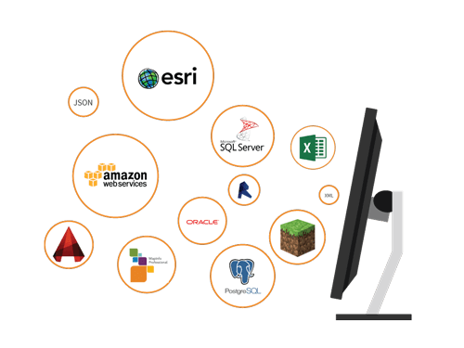

Slide 7
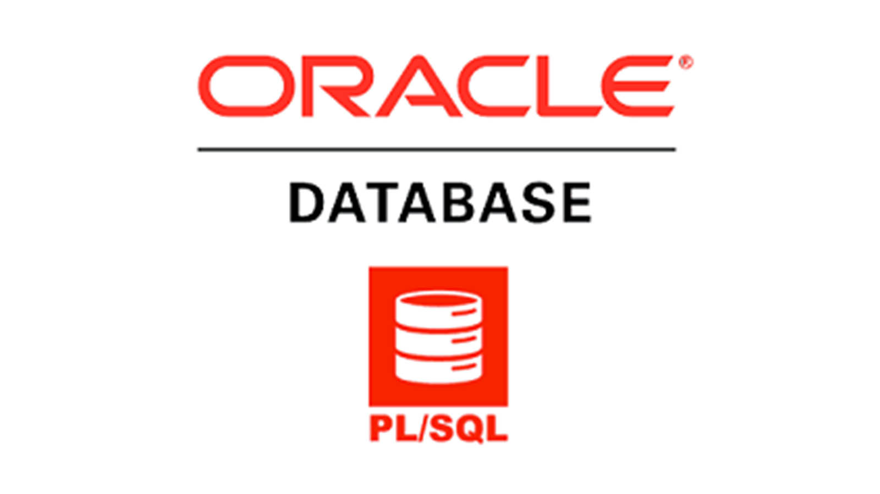
What is Oracle SQL?

Slide 8
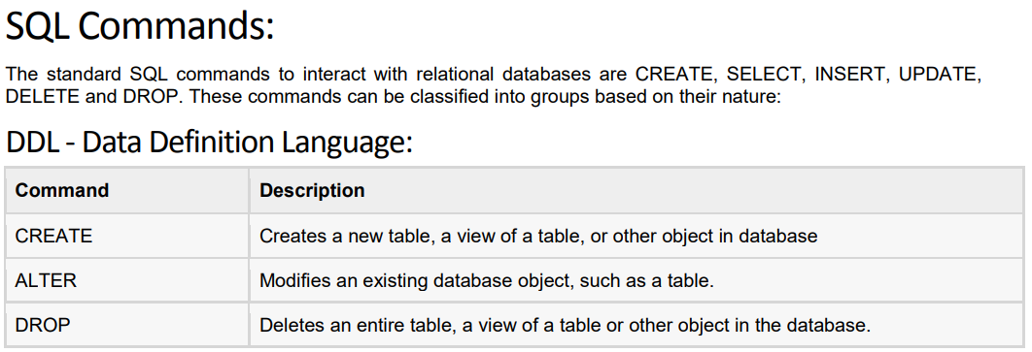
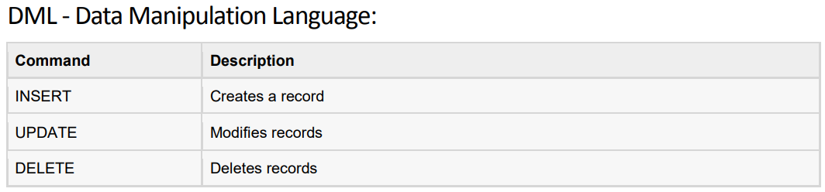

Slide 9
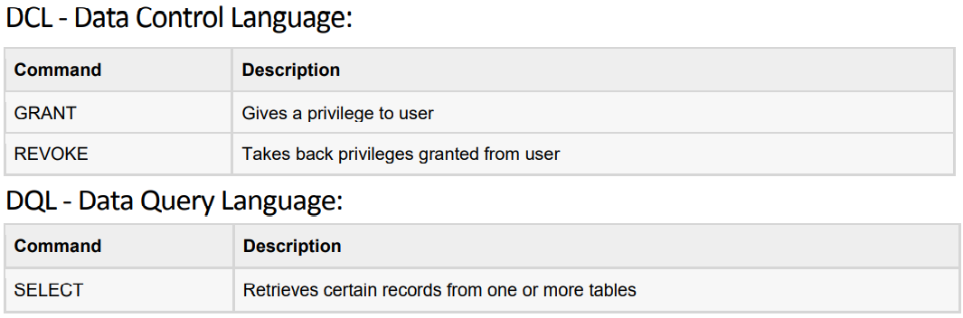

Slide 10
RDBMS Concept
What is RDBMS?
RDBMS stands for Relational Database Management System. RDBMS is the basis for SQL and for all modern database systems like MS SQL Server, IBM DB2, Oracle, MySQL, and Microsoft Access.
A Relational database management system (RDBMS) is a database management system (DBMS) that is based on the relational model as introduced by E. F. Codd

Slide 11


Slide 12
